Slide 1
Decoding Speech Perception from EEG Recordings
11785 Introduction to Deep Learning, FA2023
Team 3 : Joshua Kosnoff, Colton Gonsisko, Jooeon Kang, Sangyoun Lee
Notes:
Welcome to our presentation on "Decoding Listening Perception from EEG Recordings." We are Team 3, composed of Joshua, Colton, Jooeon, and Sangyoun.

Slide 2
Index
Introduction
Overview
Methodology (Data preprocessing & Model)
Result
Future Work
Conclusion
Notes:
Today, we will talk about our study, starting with the Introduction, followed by an Overview, and then diving into our Methodology which includes Data preprocessing & Model building. We will then share our Results, discuss Future Work, and conclude with our final thoughts.

Slide 3
Introduction

Slide 4

Introduction
Communication & Motivation
Humans are social creatures
Communication is important
A “high proportion” of patients with locked-in syndrome report having depression [1]
Restoring communication ability may improve their depressive conditions
[1] Rousseau, MC., Baumstarck, K., Alessandrini, M. et al. Quality of life in patients with locked-in syndrome: Evolution over a 6-year period. Orphanet J Rare Dis 10, 88 (2015). https://doi.org/10.1186/s13023-015-0304-z
Notes:
We all know that talking and listening are key parts of how we connect with others. But imagine if you couldn't communicate because of a medical condition. That's the reality for people with locked-in syndrome. Our project aims to use EEG, which records brain activity, to help restore the ability to communicate, which we hope will greatly improve their lives.

Slide 5
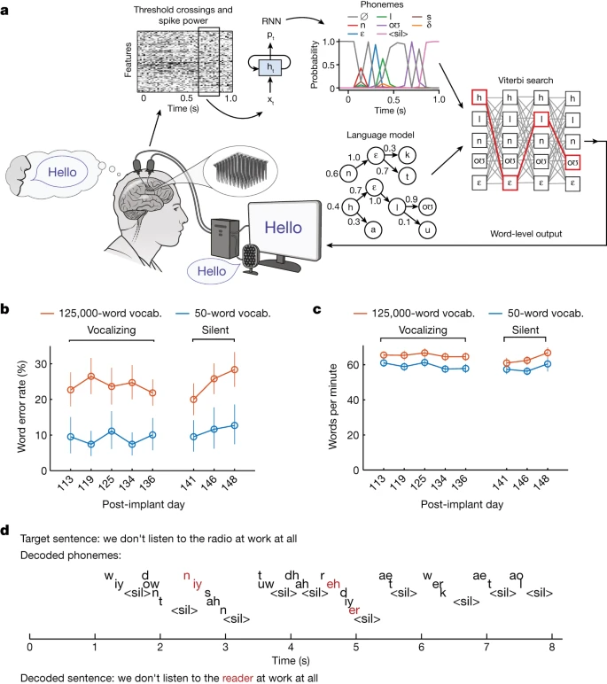
Introduction
Invasive Brain-Computer Interfaces
Major progress has been made with restoring communication ability with invasive brain-computer interfaces (BCI)
Anumanchipalli 2019: ~25% word error rate
Willlet 2023 : ~9.1% character error rate
Invasive BCI require dangerous and recurring surgeries to implant and maintain
We are interested in investigating non-invasive alternatives
[1] F. R. Willett et al., “A high-performance speech neuroprosthesis,” Nature, vol. 620, no. 7976, Art. no. 7976, Aug. 2023, doi: 10.1038/s41586-023-06377-x.
[2] G. K. Anumanchipalli, J. Chartier, and E. F. Chang, “Speech synthesis from neural decoding of spoken sentences,” Nature, vol. 568, no. 7753, Art. no. 7753, Apr. 2019, doi: 10.1038/s41586-019-1119-1.
Notes:
A lot of good work has been done with brain-computer interfaces, which can help people communicate by directly linking the brain to a computer. But these usually involve surgery, which carries risks. That's why we're looking into ways to achieve this without surgery, using non-invasive methods.

Slide 6
Introduction
Non-Invasive State of the Art
Défossez, 2023 Nature Machine Intelligence [1]
Decoded perceived speech from EEG / MEG recordings
Research into brain signals for imagined movement and actual movement suggest that the brain signals for the two are very similar! [2]
It may go to reason that brain signals for perceived speech may generate similar brain signals to generating speech.
As a result, being able to accurately decode perceived speech may be an important stepping stone in developing speech prostheses.
[1] A. Défossez, C. Caucheteux, J. Rapin, O. Kabeli, and J.-R. King, “Decoding speech perception from non-invasive brain recordings,” Nat Mach Intell, vol. 5, no. 10, Art. no. 10, Oct. 2023, doi: 10.1038/s42256-023-00714-5.
[2]Kilteni, K., Andersson, B.J., Houborg, C. et al. Motor imagery involves predicting the sensory consequences of the imagined movement. Nat Commun 9, 1617 (2018). https://doi.org/10.1038/s41467-018-03989-0
Notes:
Our approach is inspired by the latest non-invasive techniques, such as those discussed in the 2023 Nature Machine Intelligence publication by Défossez et al., which decoded perceived speech from non-invasive brain recordings.
By understanding and leveraging the similarities between brain signals for imagined and actual movement, we aim to make significant progress in non-invasive BCIs.

Slide 7
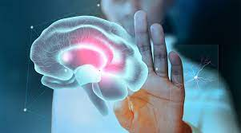
Introduction
Motivation
Medical Breakthroughs: The ability to decode brain signals into speech has profound implications for those who are unable to speak due to neurological disorders.
Technological Innovation: Non-invasive BCIs represent a frontier in technology, offering new modes of human-computer interaction.
Academic Contribution: We aim to contribute to the body of knowledge in neural decoding and machine learning, building upon the work of our predecessors.

Slide 8
Introduction
Objective
To implement and refine a deep learning model capable of processing EEG data and accurately predicting phonemes, thereby taking a step towards real-time speech synthesis from brain activity.
Generation and perception of speech are two processes that are important towards this goal. If we can decode perceived speech from noninvasive brain signals this would be promising for restoring hearing to patients with cortical deafness
https://www.ncbi.nlm.nih.gov/pmc/articles/PMC4382224/
https://www.frontiersin.org/articles/10.3389/fnins.2018.00130/full

Slide 9
Overview
Decoding speech and listening
Some previous work has successfully decoded speech from electrodes implanted into the brain [cite that one california paper that i think exists]
The same accomplishment for noninvasive recordings has yet to be accomplished
Several publications have released datasets for physiological recordings during listening which is the start of our project
Show performance of noninvasive EEG paper ? maybe also invasive if there’s space

Slide 10
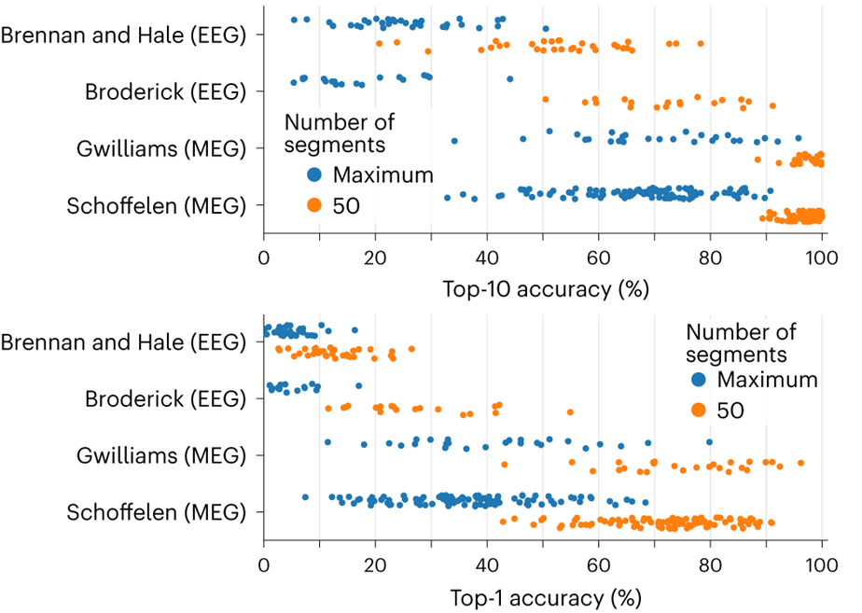
State of the Art, Colorized (circa 2023)
A. Défossez, C. Caucheteux, J. Rapin, O. Kabeli, and J.-R. King, “Decoding speech perception from non-invasive brain recordings,” Nat Mach Intell, vol. 5, no. 10, Art. no. 10, Oct. 2023, doi: 10.1038/s42256-023-00714-5.

Slide 11
State of the Art, Colorized (circa 2023)
Due to dataset availabilities and familiarity with file formats, we focused on the Brennan and Hale dataset
A. Défossez, C. Caucheteux, J. Rapin, O. Kabeli, and J.-R. King, “Decoding speech perception from non-invasive brain recordings,” Nat Mach Intell, vol. 5, no. 10, Art. no. 10, Oct. 2023, doi: 10.1038/s42256-023-00714-5.

Slide 12
Methodology
Acquire and preprocess passive-listening EEG dataset
Generate phonemes for classification
Develop DL model to decode phoneme from EEG features
Profit

Slide 13
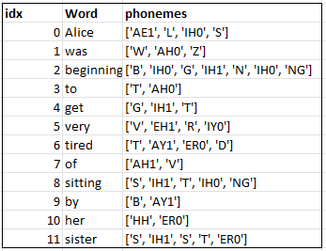

Data Preprocessing - Language
word
phoneme(s)
First 12 words / phonemes in Alice in Wonderland

Slide 14
Data Preprocessing - EEG
61 - 62 Channels
Time
Bandpass Filtered 0.5 - 40 Hz → Common Average Reference X_{i,t} = X_{i,t} - mean(X_{t} )

Slide 15
Data Preprocessing - EEG
Shared Channels
61 - 62 Channels
Time

Slide 16
Data Preprocessing - EEG
Word 2 Onset
…
Word 2 Offset
Shared Channels
Time
Word 1 Onset
Word N Onset
Word 1 Offset
Word N Offset

Slide 17
Data Preprocessing - EEG
Time
Channels (61)
Downsampled to 100 Hz to reduce computational complexity
Words
x N Subjects

Slide 18
Data Preprocessing - Train / Validation Partitioning
Input data
Output labels:
Sklearn Train-Test Split
Time
Phoneme(s)
80% Training Data
Channels (61)
Words
20% Validation Data
x N Subjects
x N Subjects

Slide 19
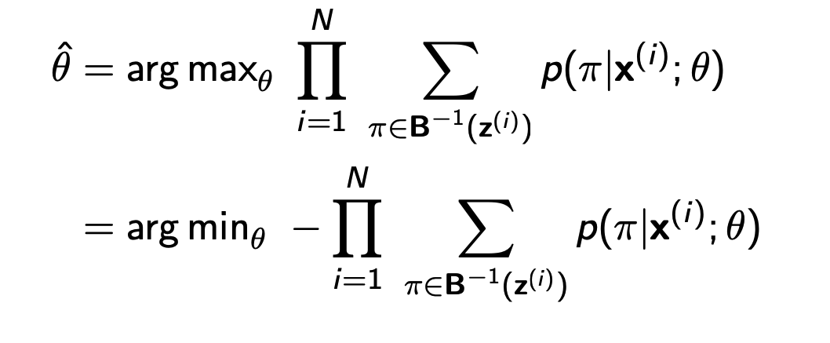
The Model: EEG2Phoneme (A HW3P2 Reimagining)
Phonemes
Time
Channels (61)
5 layer bidirectional LSTM (20, 512)
3 layer MLP and softmax
1 layer convolution projection layer
(62, 20)
batchnorm layer
(1024)
Words
Words
x N Subjects
x N Subjects
Loss: CTC Loss

Slide 20
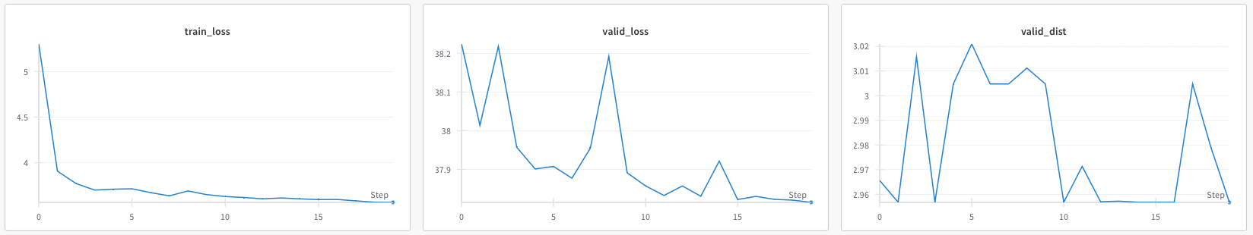
Results
Comparable to state of the art (~5% top-1 word accuracy rate)!
(1- Valid Distance / Avg Length) = 1 - error rate = accuracy rate
(1 - 2.96 / 3.21) = a whopping ~7% phoneme accuracy rate!

Slide 21
Future Work
Try to implement EEG2Word (a HW4P2 Reimagining)
Phonemes are not as useful for communication as text
Will give us the same metric as STOA (word error rate) to compare to

Slide 22
Conclusions
We can predict perceived phonemes with limited accuracy from EEG data
Phoneme accuracy rate is roughly on par with state of the art’s reported word accuracy rate
7% accuracy is still not likely to be clinically useful

